Slide 1

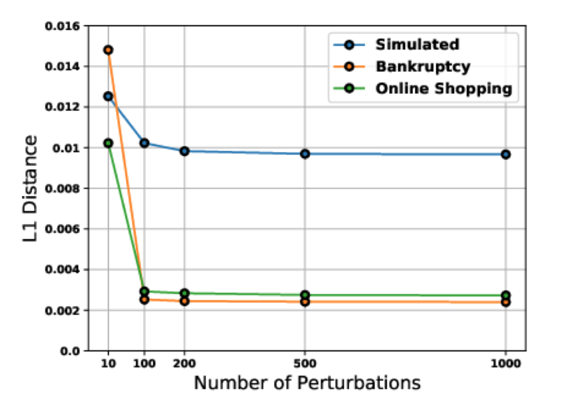
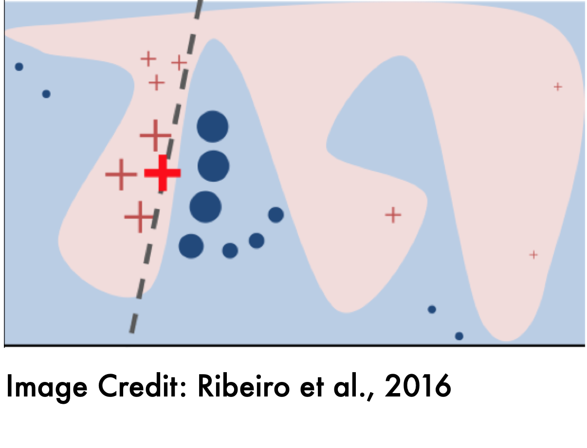
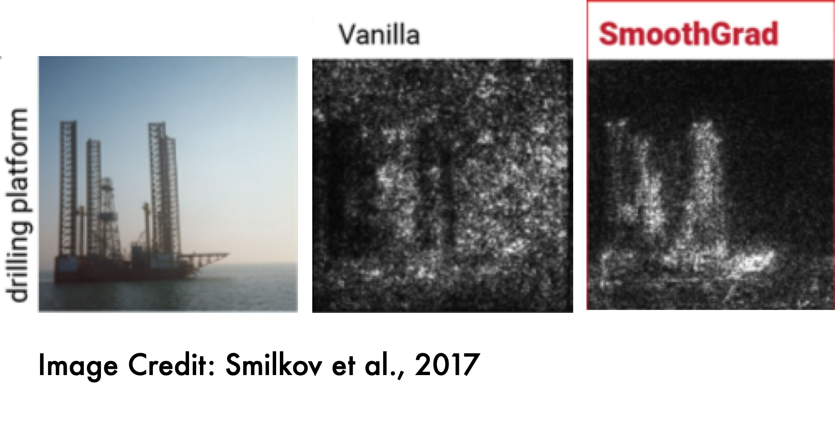
Towards Unification and Robustness of Perturbation and Gradient Based Explanations
Sushant Agarwal, Shahin Jabbari, Chirag Agarwal, Sohini Upadhyay, Zhiwei Steven Wu, Himabindu Lakkaraju
jabbari@seas.Harvard.edu
Motivation
LIME
Experiments
Goal: explaining a complex function at a fixed point
Previous post-hoc explanations:
Perturbation based (LIME, SHAP)
Gradient based (GradCAM, SmoothGrad)
Shortcomings:
Studied separately with no clear connections
Empirical evaluations without theoretical guarantees
A perturbation based approach
Trains a simple model over nearby points
C-LIME: continuous
features, linear model
Theoretical Results
Explanations by SmoothGrad and C-LIME are equal in expectation
Finite sample bounds for convergence to expectation
Both SmoothGrad and C-LIME are robust
Similar explanations for nearby points with the same label
Other desirable properties like proportionality and linearity
SmoothGrad
Summary
A gradient based approach
Averaging the derivatives over nearby points
Establishing the first theoretical connection between gradient based and perturbation based explanations
Theoretical analysis of SmoothGrad and C-LIME
https://arxiv.org/abs/2102.10618

